Slide 1
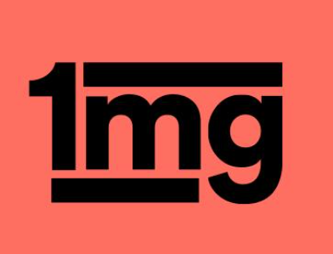

1 Mg Homeopathic
A Web Scraping Project

Slide 2

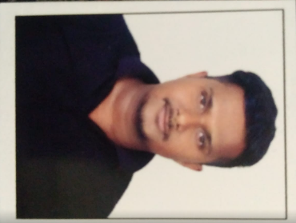
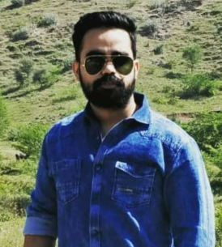
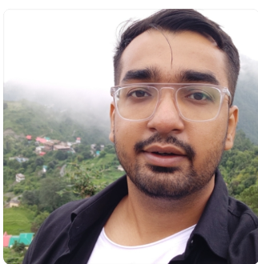
Team Members
Rahul Bisht
PT DA 16_304
Prince Kr. Singh
PT DA 17_059
Praveen Sharma
PT DA 17_138
Rajat Tokas
PT DA 17_159

Slide 3
01
03
02
04
Objectives
Scraped the site data and created a dashboard with useful insights.
Results analysis
Insights speak of :
Brands’ Market’s Standing
Most Used Ingredient
Reviews Rating
Price Analysis
Brand’s Key Focus Areas
Approach
Data scraping, data cleaning using Python IDE & its libraries
Data visualisation and insights generation using Excel and PowerBi
Conclusions
After analyzing the insights, we can suggest the useful ideas for upscaling the homeopathic store.

Slide 4
HOMEO INSIGHTS

Slide 5
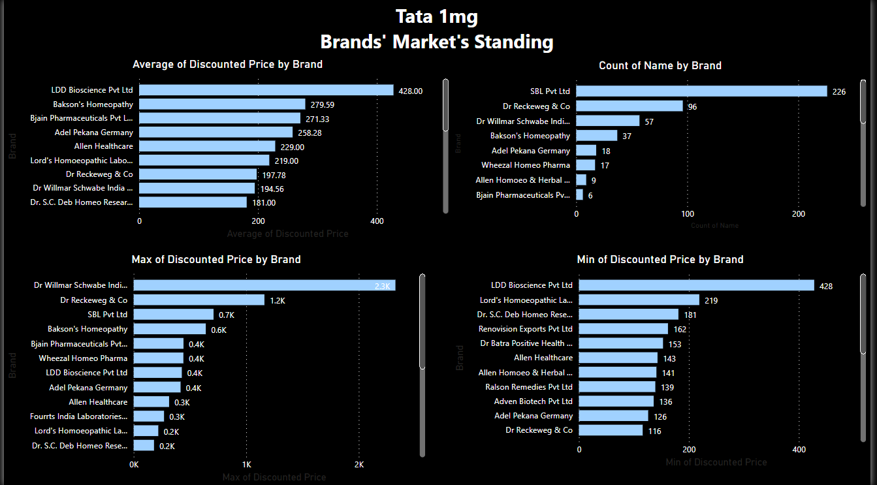
Brands’ Market Standing

Slide 6
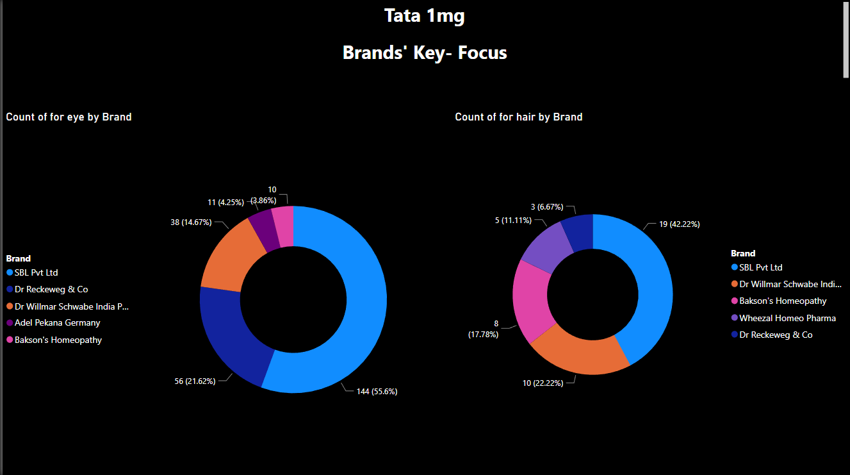
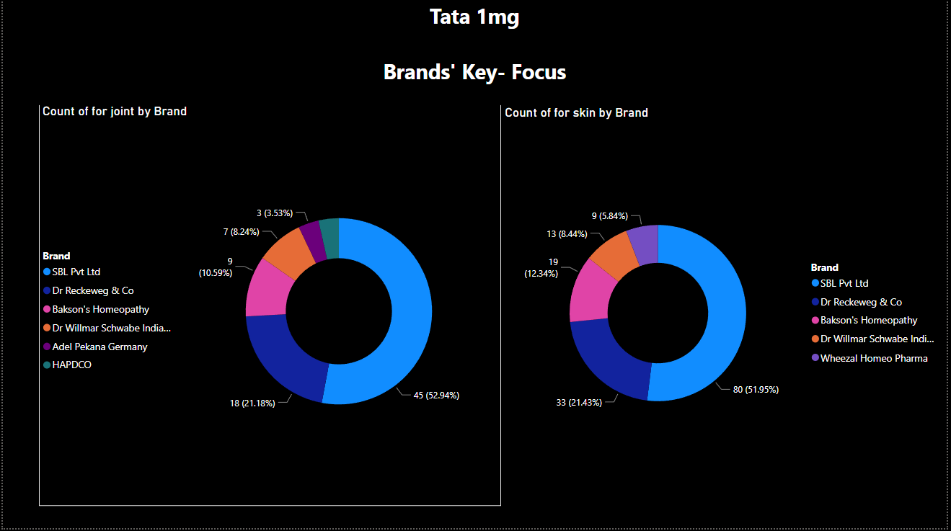

Brands’ Key Focus
BRANDS’ KEY FOCUS gives an insight about how the brands are targeting the specific body parts.
Key Focus are on :
Eyes
Hair
Skin
Joints

Slide 7
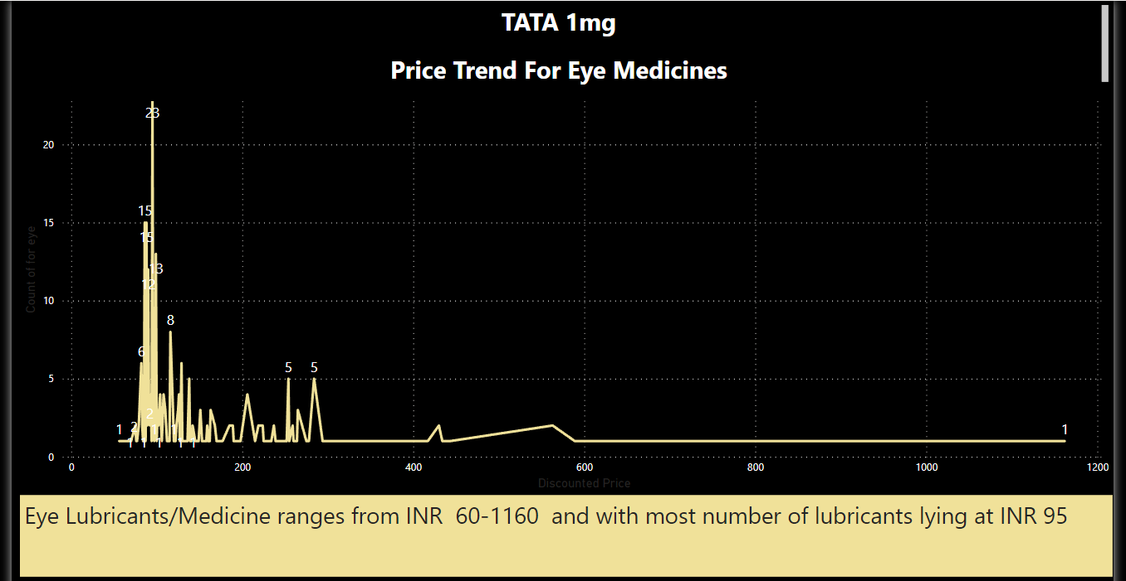
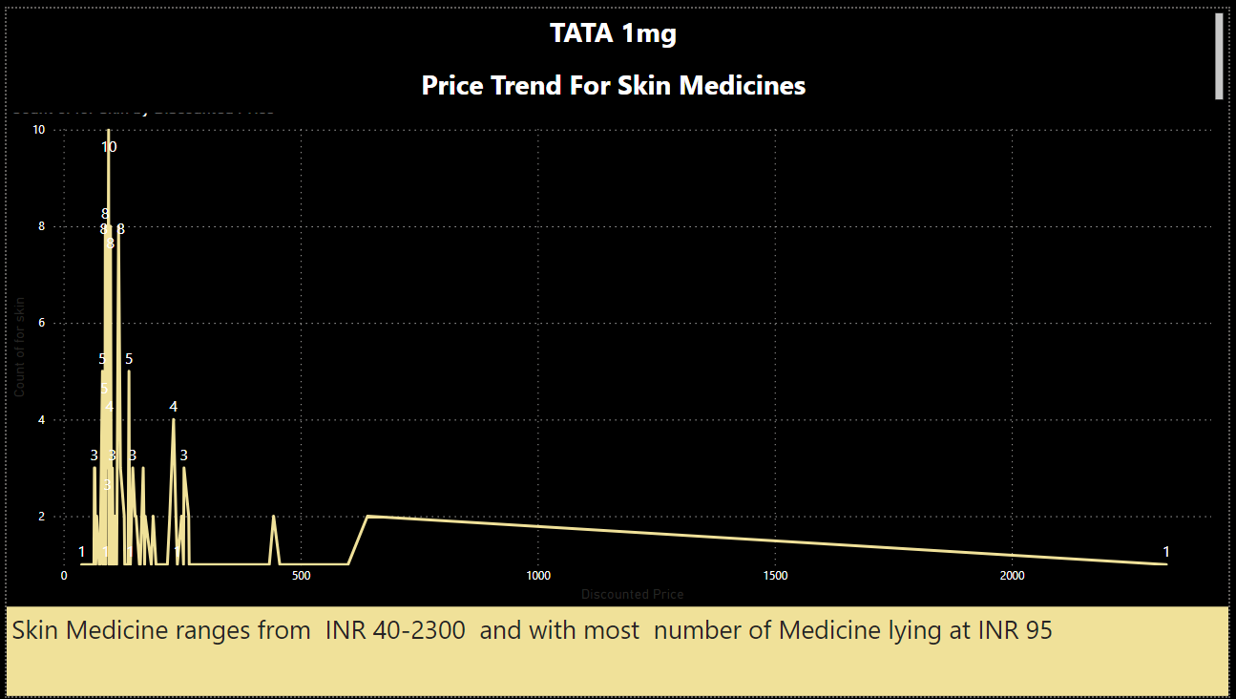
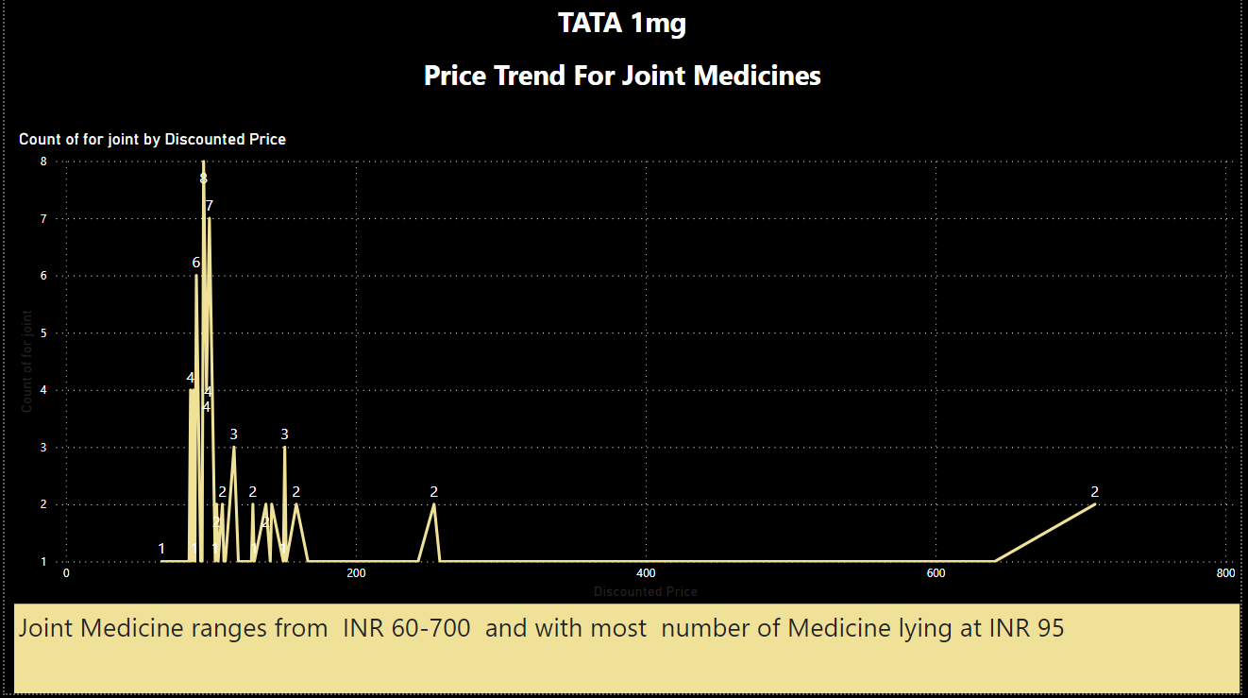
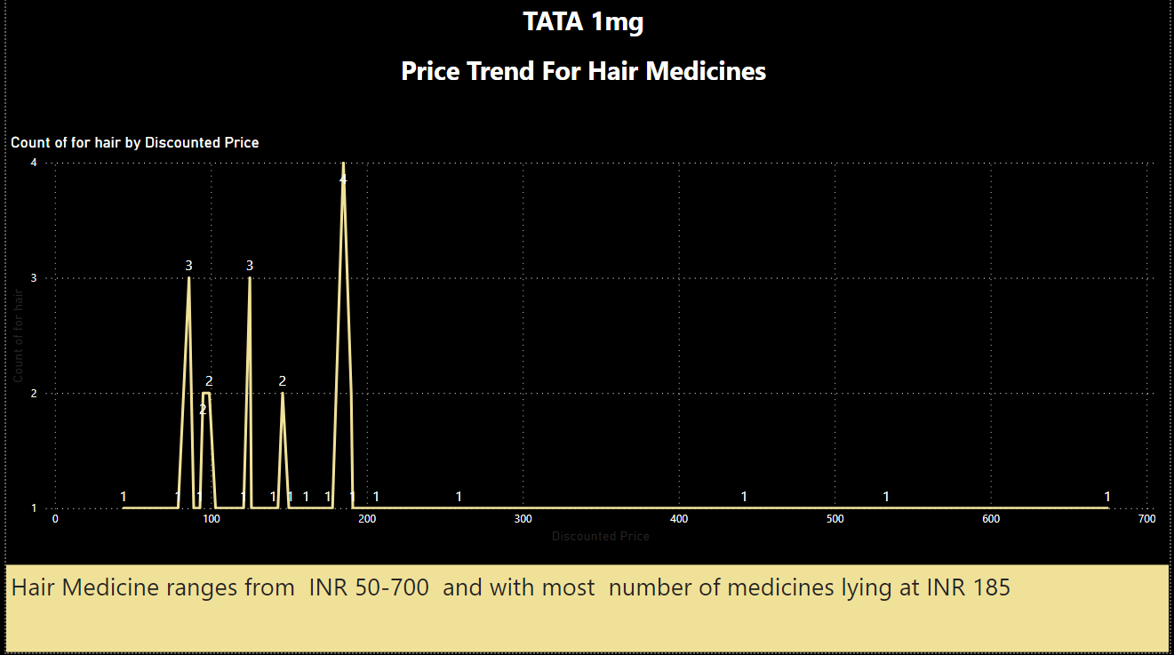

Slide 8
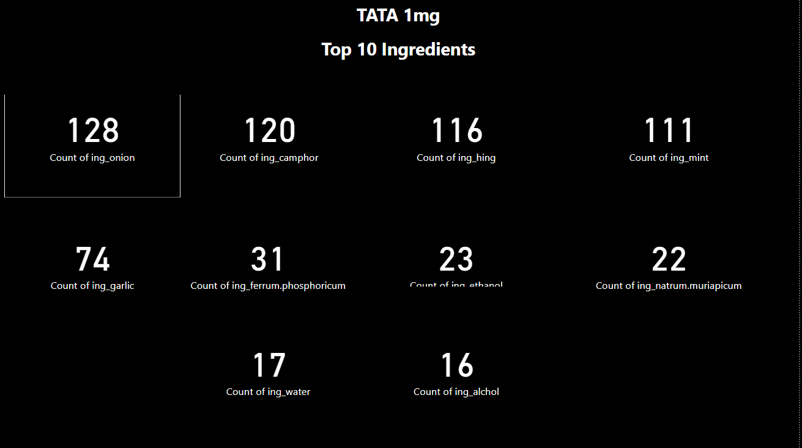
MOST USED INGREDIENTS
Star ratings gives us an insight about the user feedback after the product usa

Slide 9
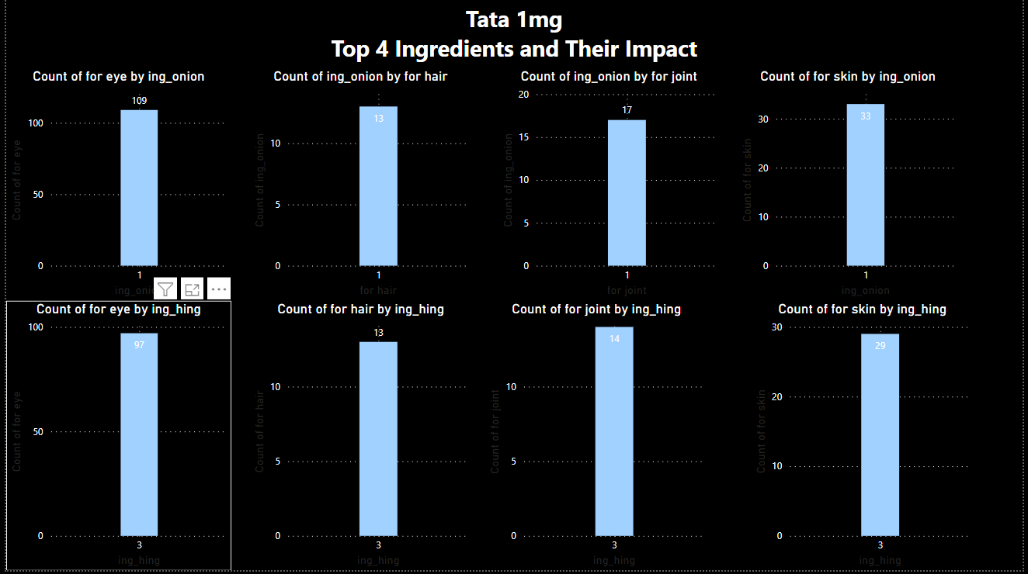
INGREDIENTS AND THEIR IMPACT

Slide 10
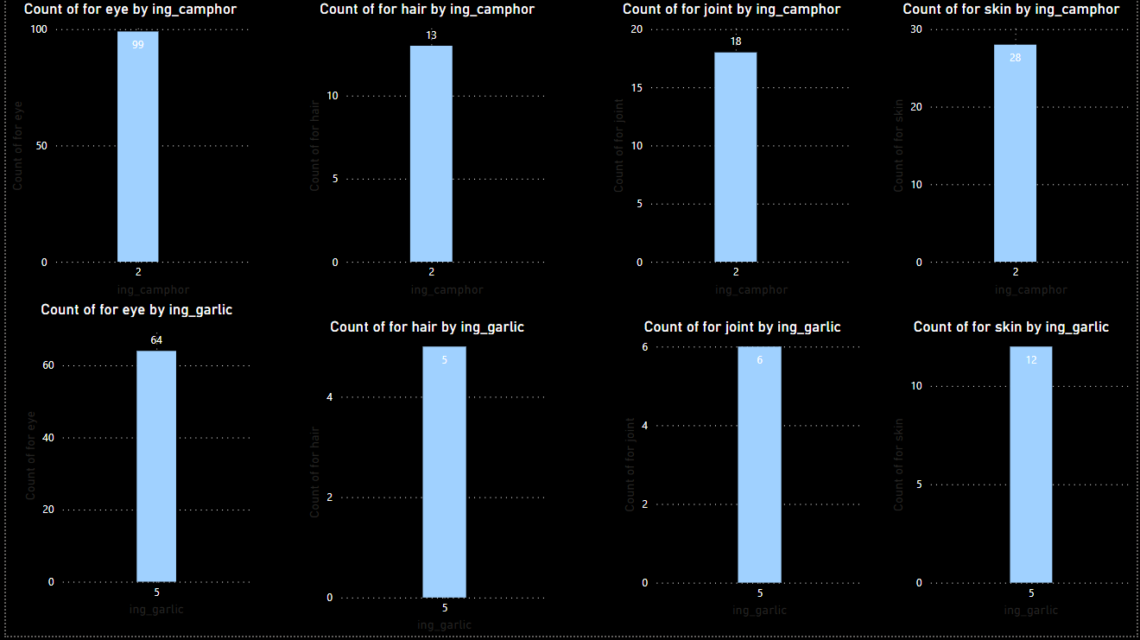
INGREDIENTS AND THEIR IMPACT

Slide 11
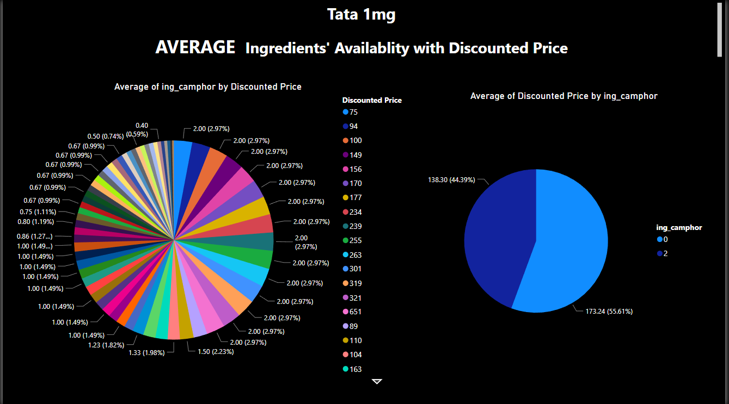
INGREDIENTS AVAILABILITY WITH DISCOUNTED PRICE

Slide 12
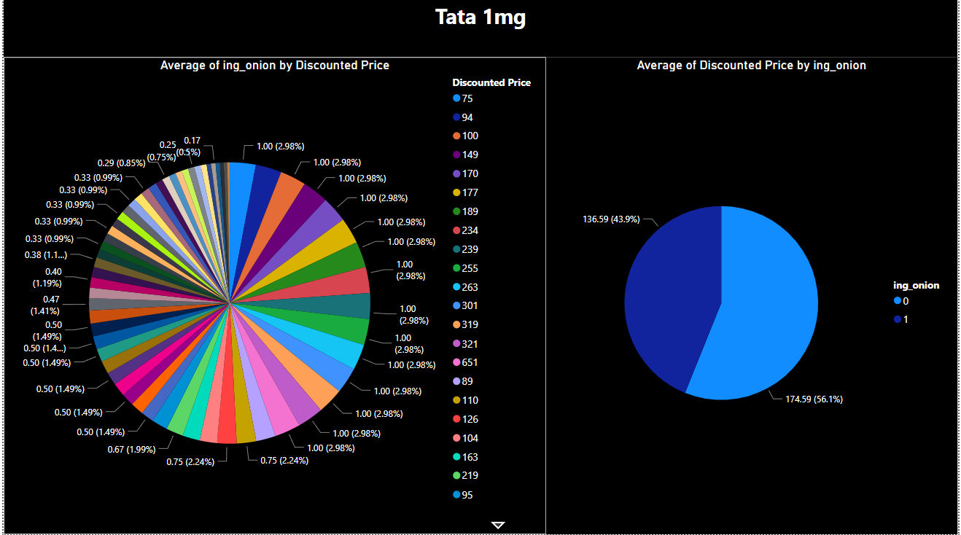
INGREDIENTS AVAILABILITY WITH DISCOUNTED PRICE

Slide 13
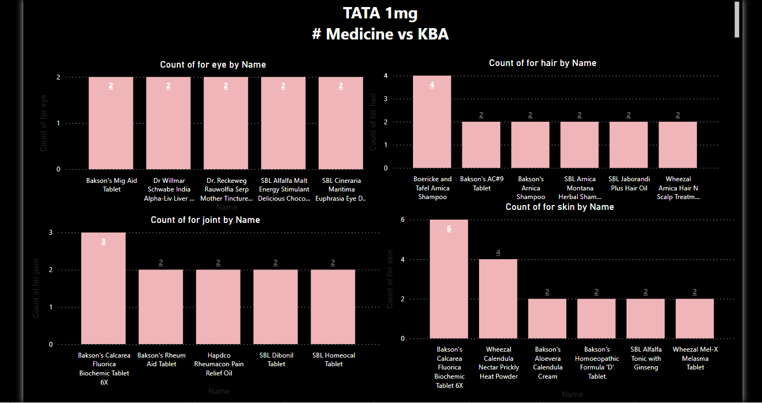

Slide 14
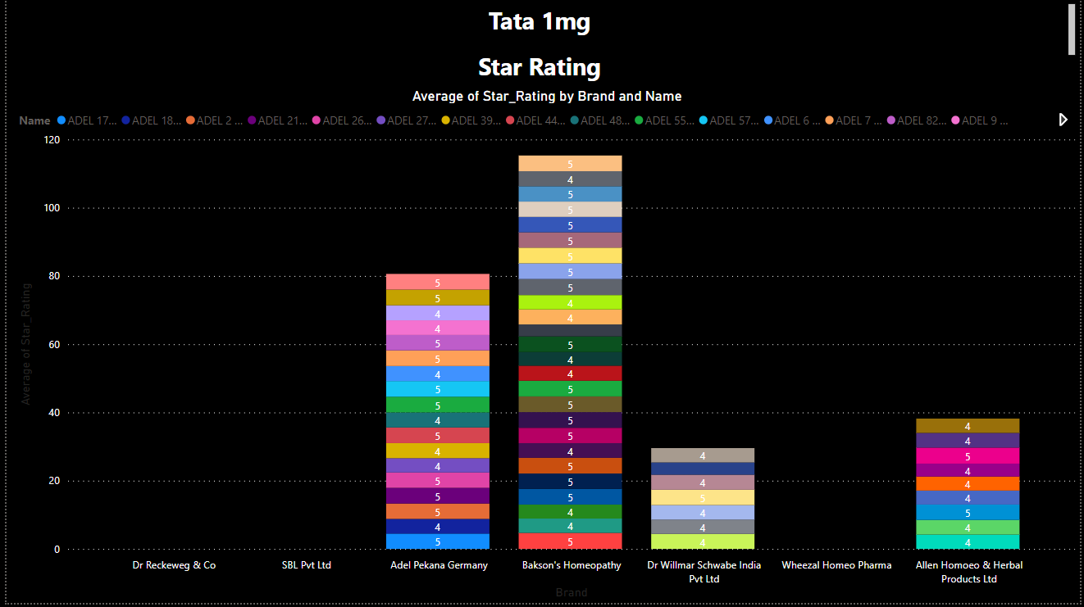
CUSTOMER REVIEWS
Star ratings gives us an insight about the user feedback after the product usage.

Slide 15
DASHBOARD

Slide 16
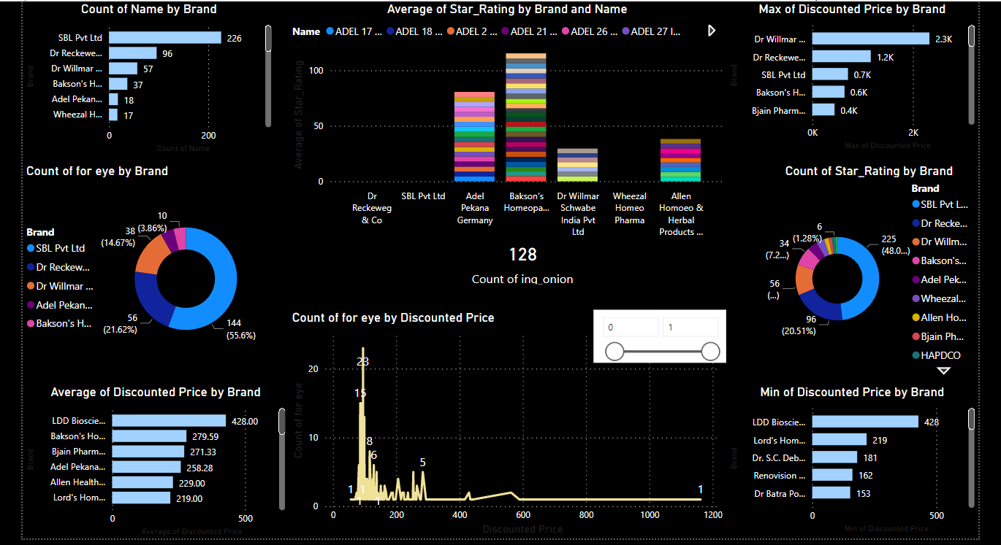

Slide 17
CHALLENGES FACED
CHALLENGES FACED
DATA SCRAPING & CLEANING
TIME MANAGEMENT
WORKING
ON EXCEL
Concept was new to us. We had to explore various sources to understand how it works. Then performing EDA on the data and segregating it were hard.
We are all from diverse fields, and work at different times. So we had to take individual ownership of tasks and ensure their timely completion.
Laborious, time-consuming efforts were taken on segregating the key benefit areas and targeting the key ingredients on Excel.

Slide 18
CONCLUSION
After analyzing the insights, we can suggest the homeopathic store, the following :
The most trusted and available brand is Bakson’s Homeopathy.
The most economic brand is LDD Bioscience.
As per our analysis, SBL Pvt. Ltd. focuses on the entire Key body segments such as Hair, Joint, Eyes & Skin because of their highest listed medicines.
Average price by segments for the Eyes, Joints and Skin lie at INR 95 while for Hair, it is valued at INR 185.
The most commonly used medicines:
Eyes – Bakson’s Mid Aid Tablet
Hair – Boericke Tafel Amica Shampoo
Joint –Bakson’s Calceria Fluorica Tab
Skin - Bakson’s Calceria Fluorica Tab

